Slide 1
Understanding Job Orchestration & Triggers
Presenter:
February 16, 2018

Slide 2
Understanding Job Orchestration & Triggers
What is a subjob
o A simple subjob
o Jobs as subjobs
Understanding Triggers
o On Subjob OK
o On Component OK
o On Subjob Error
o On Component Error
o Run If
Iterating and looping
o Iterate connections
o ForEach loop
o Loop "n" times
o Infinite loop

Slide 3
What is a Subjob?

Slide 4
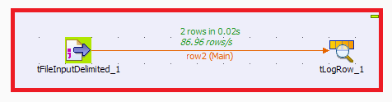
Subjob
A subjob is a subset of the components in a job. A subjob can be viewed as a grouping of components that undertake a discrete part of the overall integration job.
A Simple Subjob

Slide 5
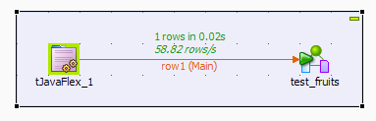
Jobs as Subjob
Talend Open Studio allows developers to use jobs within jobs. This is a great technique to use if you have tasks that can be used over and over again in many integration jobs.

Slide 6
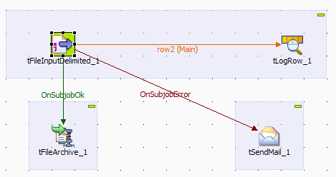
Understanding Triggers
OnSubjobOK
This trigger means when the whole of the first subjob completes (without error), execute the second subjob.
OnSubjobError
This trigger means when the first subjob exits with errors execute the second subjob.

Slide 7
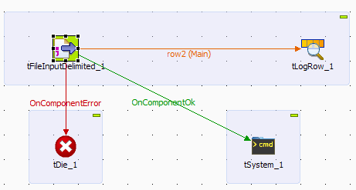
Understanding Triggers
OnComponentOK
When we require another subjob to commence as soon as a specific component within a subjob is complete, rather than waiting until all of the components are complete, this trigger is used.
OnComponentError
When we require another subjob to commence as soon as a specific component within a subjob throws some error OnComponentError trigger is used.

Slide 8
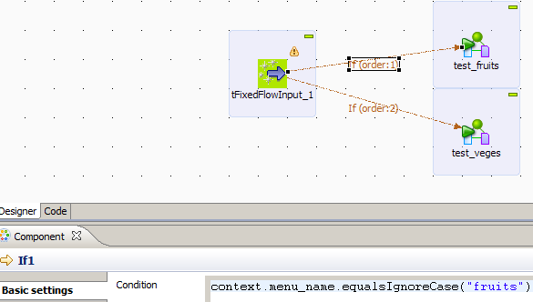
Understanding Triggers
RunIF
Run If triggers a subjob or component when a defined condition is met

Slide 9
Iterating and looping
Looping and iterating structures are common to most programming languages and Talend Open Studio is no different. Some ways in which Talend achieves them are:
Iterate connections
ForEach loop
Loop "n" times
Infinite loop

Slide 10
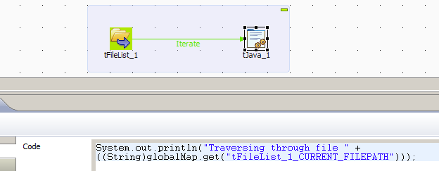
Iterate Connections
The Studio offers an Iterate flow option from its start components, that is, those that can commence a subjob or flow, often in addition to a Main flow.
This connection is used to iterate the flow between components, e.g.
iterating through the files in a directory and passing these filename values onwards one by one.

Slide 11
ForEach loop
ForEach component allows us to loop through a set of values and pass these onto the next component using an iterate link.

Slide 12
Loop "n" times
Talend’s tLoop component is used when logic want a process to execute a certain number of times

Slide 13
Infinite loop
We can take the looping concept a step further by introducing an infinite loop for those jobs that you want to run forever. This can be done using Talend component tInfiniteLoop.

Slide 14
Questions?
Copyright © 2014 by Vikram Takkar. All Rights Reserved..

